Slide 1

Computer Graphics
CS C 471 and IS C 471
Dr. Lucy J. Gudino
Computer Science & Information Systems Group
Birla Institute of Technology & Science, Pilani, Goa Campus

Slide 2
Visible Surface Detection
Goal: Determine which surfaces are visible and which are not.
Display all visible surfaces, do not display any occluded surfaces.
Also known as Hidden-Surface elimination methods or hidden line elimination

Slide 3
Contd..
based on whether algorithms deals with object definitions only or with their projected images : two approaches
  Object-Space methods or object precision methods
  Image-space methods

Slide 4
Object Space Methods:
whole object or part of the object is compared for visibility
Algorithm:
  For each object in the scene do
  Begin
  1. Determine those part of the object whose view is unobstructed by other parts of it or any other object with respect to the viewing specification.
  2. Draw those parts in the object color.
  End

Slide 5
Contd…
implemented in physical (world ) coordinate system
If there are n objects in the scene, complexity = O(n²)
Resize doesn’t require recalculation
Works for static scenes and suitable for scene with small number of objects and objects with simple relationship with each other.
May be difficult to determine
Display is more accurate but computationally more expensive as compared to image space
methods because step 1 is typically more complex, eg. due to the possibility of intersection between surfaces.

Slide 6
Image Space Methods
Most commonly used method
Visibility is decided point-by-point at each pixel position on the projection plane
Algorithm:
  Begin
    1. Determine the object closest to the viewer that is pierced by the projector through the pixel
    2. Draw the pixel in the object colour.
  End

Slide 7
Contd…
For each pixel, examine all n objects to determine the one closest to the viewer.
If there are p pixels in the image, complexity depends on n and p ( O(np) ).
Accuracy of the calculation is bounded by the display resolution.
A change of display resolution (resize) requires re-calculation
    Works for dynamic scenes

Slide 8
Techniques
VSD involves costly operations
  determination of projections of objects
  whether objects intersect or not
  where they intersect and so on
Most techniques use sorting and coherence methods to improve the performance
  sorting: facilitates depth ordering
  Coherence
    the degree to which parts of an environment or its projection exhibit local similarities
      color, depth, texture etc.
Notes:
Coherence denotes similarities between items or entities. It describes the extent to which these items or entities are locally constant. In many situations properties do not change drastically but rather in a smooth or continuous way. Coherence is based on the principle of locality, whereby "nearby" things do have the same or similar characteristics. In the field of computer science and computer graphics coherence properties have been exploited in a variety of different methods and techniques. With coherence processing of data can be accelerated considerably, e.g., hidden line/hidden surface removal.
Data can be stored more efficiently by eliminating redundancies due to coherence, e.g., run length encoding of raster images. Some approximate or incremental techniques are only useful in coherent situations, e.g., Newton iteration to determine the roots of a polynomial. In a coherent situation incremental methods can be designed that process an item by reusing the results obtained for a similar (coherent) item. Exploiting coherence leads to algorithms based on an incremental application of very simple operations, that in many cases can use "integer logic" to replace time-consuming floating-point arithmetic.
Object coherence is based on some known relationships between objects or between parts of the same object. Objects may be disjoint, may be closely clustered or may consist of collections of low-level geometry, which usually are connected, smooth and bounded (e.g., polygons, surfaces). Local neighborhoods of space are likely to be occupied by the same objects. Depending on the given relations, manipulations like clipping, sorting, comparison, or intersection can first be performed at the object level to reduce the complexity and volume of calculations on low-level geometry.

Slide 9
Coherence
Object coherence: if one object is entirely separate from another, comparisons may need to be done only between the two objects, and not between their components faces or edges
Face coherence: Usually surface properties vary smoothly
  computations for one part of face to be used with incremental changes to other parts of the face
Edge coherence: The visibility of edge may change only when it crosses a visible edge or penetrates a visible face

Slide 10
Coherence
Area coherence: A group of adjacent pixel is often belong to the same visible face
Span coherence :Special case of area coherence.
  visibility of face over a span of adjacent pixels on a scan line
Scan line coherence: The set of visible object spans determined for one scan line of an image typically changes very little from the set on the previous line

Slide 11
Coherence
Depth coherence: Adjacent parts of the same surface are typically same or very close depth.
  use incremental method
Frame coherence: Pictures of the same scene at two successive points in time are likely to be quite similar, except small changes in objects and view port

Slide 12
VSD methods
Back-face detection
Depth-sorting method
Depth buffer method
Scan-line method
Area-subdivision method
Qctree methods
BSP tree method
Ray-casting method

Slide 13
Back-Face detection/culling
Object space methods
fast and simple method
uses front-back test to locate back faces of a polyhedron

Slide 14
Back-Face detection/culling
Don’t draw surfaces facing away from viewpoint:
  Assumes objects are approximated using solid polyhedron
  Compute polygon normal n:
    Assume counter-clockwise vertex
    order
    For a triangle (a, b, c): n = (b – a) × (c – a)
  Compute normal vector v from viewpoint to any point p on polygon
  Facing away (don’t draw) if n and v are
  pointed in opposite directions →
  dot product n · v > 0
c
n
a
b
y
x
z
Notes:
poly : many, hedron : faces . Polyhedron is a geometric solid in three dimensions with flat faces and straight edges.

Slide 15

Contd…
n₁·v = (2, 1, 2) · (-1, 0, -1)
= -2 – 2 = -4,
so n₁·v < 0
so n₁ front facing polygon
n₂ = (-3, 1, -2)
n₁ = (2, 1, 2)
n₂ ·v = (-3, 1, -2) · (-1, 0, -1)
= 3 + 2 = 5
so n₂ · v > 0
so n₂ back facing polygon
v = (-1, 0, -1)

Slide 16
Contd…
If the viewpoint is on the +z axis looking at the origin, we only need to check the sign of the z component of the object’s normal vector
  if n_{z} < 0, it is back facing
  if n_{z} > 0 it is front facing
  What if n_{z} = 0?
    the polygon is parallel to the view direction, so we don’t see it

Slide 17
OpenGL Back-Face Culling
Enable back-face removal with glEnable(GL_CULL_FACE);
Disable back-face removal with glDisable(GL_CULL_FACE);
Then, select which polygons to remove with one of the following functions:
  glCullFace(GL_BACK);
  glCullFace(GL_FRONT);
  glCullFace(GL_FRONT_AND_BACK);
The default is GL_BACK, so that the back-facing polygons are removed.
However, remember that in a polyhedron, the convention is to specify the triangles such that the outward face is the front face. Therefore, if the camera happens to be inside the polyhedron, we would use glCullFace(GL_FRONT) to get rid of the front-facing polygons, so that we see the back-facing ones only.

Slide 18
Depth Buffer Method
Also known as Z-buffer method
Belongs to “image space approach”
compares surface depth values throughout the scene
method usually applied to scenes containing only polygon surfaces
Notes:
method applied to scenes containing only polygon surfaces, because depth values can be computed very quickly and the method is easy to implement

Slide 19
Contd…
Each (X,Y,Z) point on a polygon surface, corresponds to the orthographic projection point (X, Y) on the view plane.
Object depth is usually measured from the view plane along the z axis of a viewing system.
Two buffer are used:
  (i)Depth (Z) buffer: To store the depth values for each (X, Y) position, as surfaces are processed.
  (ii)Refresh or Image Buffer: To store the intensity value at each position (X, Y).

Slide 20
Z-Buffer
The Z-Buffer is usually part of graphics card hardware. It can also be implemented in software
The Z-Buffer is a 2D array that holds one depth value for each pixel
Z-buffer and Image buffer have same resolution as the image to be captured.
As surfaces are processed, the image buffer is used to storethe color values of each pixel position and the z-buffer is used to store the depth values for each (x,y) position.

Slide 21
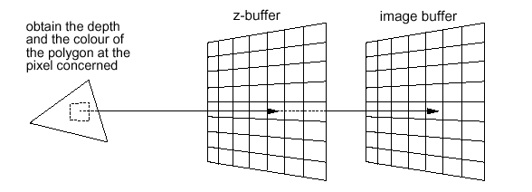
Contd…

Slide 22
Steps for Processing
Z-Buffer has memory corresponding to each pixel location
Initialize :-
  Each z-buffer location ⇐ Max z value
  Each frame buffer location ⇐ background color
For each polygon :-
  Compute z(x,y), polygon depth at the pixel (x,y)
  If z(x,y) < z-buffer value at pixel (x,y) then
    z-buffer (x,y) ⇐ z(x,y)
    Pixel (x,y) ⇐ color of polygon at (x,y)

Slide 23
Contd…
Hardware implementations of the algorithm are available in some graphics workstation.

Slide 24
z-buffer Algorithm: Advantages
Simple and does not require additional data structures.
Polygons can be rendered in any order
The z-value of a polygon can be calculated incrementally.
No pre-sorting of polygons is needed.
No object-object comparison is required.
Can be applied to non-polygonal objects (need to compute depth and shading values at each pixel)
The z-buffer can be saved with the image and used later to merge in other objects whose z can be computed

Slide 25
z-buffer Algorithm: Disadvantages
High memory requirements
The required z-precision is maintained at a higher resolution as compared to x,y precision
Aliasing problems (due to finite-precision)
Issues in implementing transparency and translucency effects (due to arbitrary order of rendering)
Note:For large images, the algorithm could be applied to, eg., the 4 quadrants of the image separately, so as to reduce the requirement of a large additional buffer.

Slide 26
Depth Sorting Algorithm (Painters Algorithm)

Slide 27
Contd…
uses both image space and object space operations
Depth sorting method performs the following basic functions
  1. Sort all surfaces according to their distances from the view point.
  2. Render the surfaces to the image buffer one at a time starting from the farthest surface.
  3. Surfaces close to the view point will replace those which are far away.
  4. After all surfaces have been processed, the image buffer stores the final image.
Sorting operations are carried out in both image and object space, scan conversion in image space

Slide 28
Contd…
method is simple
fast in case of few objects
as the number of objects increases, the sorting process can become very complex and time consuming.
After sorting, perform depth overlap test.
If no depth overlaps occur, surface can be scan converted or else make some additional comparisons to determine whether any of the surfaces should be reordered.
Notes:
After sorting, surface with the greatest depth is then compared to other surfaces in the list to determine whether there are any overlaps in depth. If no depth
overlaps occur, S can be scan converted. This process is repeated
for the next surface in the list. However, if depth overlap is
detected, we need to make some additional comparisons to
determine whether any of the surfaces should be reordered.

Slide 29
Contd…
First, assume that we are viewing along the z direction
In first pass, all surfaces in the scene are ordered according to the smallest z value on each surface
The surface S at the end of the list is then compared against all other surfaces to see if there are any depth overlaps
If no overlaps occur, surface S is the most distant surface and is scan converted

Slide 30
Depth Overlapping
z
z
z_{max}
z_{max}
S
S
z’_{max}
z_{min}
S’
z’_{max}
z_{min}
S’
z’_{min}
z’_{min}
x
x
No Depth Overlap
Depth Overlap

Slide 31
When there is depth overlap, we make the following 4 tests
  1. The bounding rectangles (coordinate extends) in the xy directions for the two surfaces do not overlap
  2. Surface S is completely behind the overlapping surface relative to the viewing position (BACK)
  3. The overlapping surface is completely in front of S relative to the viewing position (FRONT)
  4. The projections of the two surfaces onto the view plane do not overlap

Slide 32
Contd…
Tests must be performed in order, as specified.
If any one of the 4 tests is TRUE, we proceed to the next overlapping surface.
RE-ORDERing is required if all the four tests fail.

Slide 33
Area Subdivision Algorithms
(Area Partitioning)

Slide 34
Contd..
is a image space method
The area-subdivision method takes advantage of area coherence
  area coherence - adjacent pixels are typically on the same face
Area coherence is used to locate those view areas that represent part of a single surface.

Slide 35
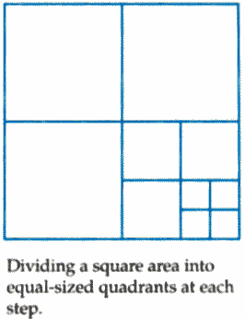
Contd…
Divide-and-conquer strategy –
  The total viewing area is successively divided into smaller and smaller rectangles until each small area is simple, ie. it is a single pixel, or is covered wholly by a part of a single visible surface or no surface at all.

Slide 36
Warnock Algorithm:
Recursive Subdivision
At each stage, the projection of each polygon has one of the four relationships to the area of interest
  Surrounding polygons A surface that completely encloses the area of interest
  Intersecting polygons intersect the area of interest
  Contained polygons or Inside polygons are completely inside the area
  Disjoint polygons or Outside polygons are completely outside the area

Slide 37
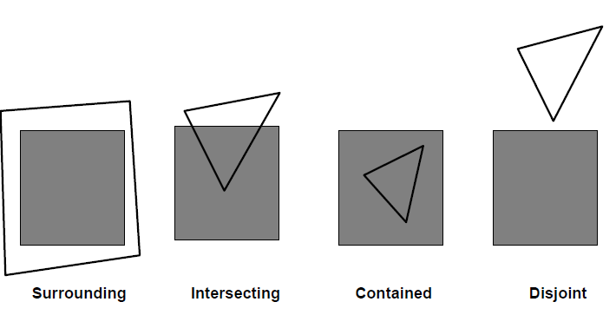
Contd…
Overlapping
Inside
Outside

Slide 38
Warnock Algorithm : Test Cases
TEST 1 – Disjoint
  are all polygons disjoint from area?
    checking bounding rectangles
  display background color
TEST 2 – Intersecting or Contained
  only one intersecting or contained polygon
    checking bounding rectangles
  fill with background color, and then draw contained polygon or intersecting portion
Example

Slide 39
Contd..
TEST 3 – one surrounding surface obscures all other surfaces within the viewing area
  minimum depth ordering
ELSE - subdivide the area into 4 equal areas and recurse
No further subdivision possible (pixel resolution reached)
  sort surfaces and take intensity of nearest surface
Example

Slide 40
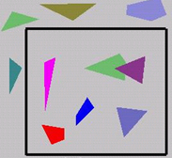
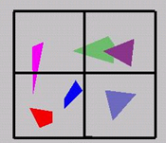
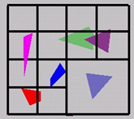
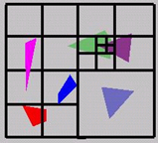
Example
Test

Slide 41
Contd…
Pros:
  Very elegant scheme
  Extends to any primitive type
Cons:
  Hard to embed hierarchical schemes in hardware
  Complex scenes usually have small polygons and high depth complexity
    Thus most screen regions come down to the
    single-pixel case

Slide 42
Ray Casting
Also known as ray tracing
is an image space technique for rendering 3D scenes
Determines the visibility of surfaces by tracing imaginary rays of light from the viewers eye to the object of the screen
  A ray tracer is any program that implements this method

Slide 43
Procedure
start from the eye or camera
Find out which objects the ray of light intersects.
Then, determine which one of these objects is closest to the viewer.
Then, set the pixel color to this object.
If the ray misses all objects, then that pixel is shaded the background color

Slide 44
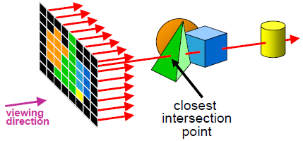

Slide 45
Contd…
A basic ray tracer consists of three parts
  Ray generation: this computes the origin and direction of each pixel’s viewing ray based on the camera geometry
  Ray intersection: it finds the closest object intersecting the viewing ray
  Shading: it computes the pixel color based on the results of ray intersection

Slide 46
Ray Casting Algorithm
The basic ray casting algorithm involves throwing a lot of rays into the scene -
  For each pixel on the screen, a ray is cast from the eye, through that pixel, and into the image’s space
  Then, every object in the scene is tested to see if the given ray intersects any of them
  If there are multiple objects in a scene, it is possible that any given ray may intersect more than one object (if, for instance, one object is behind another)

Slide 47
Contd…
For each ray, the intersection that is nearest to the eye is the one that is visible to the eye
The intensity (that is, color) at that point is the color that is given to the pixel through which the ray passed

Slide 48
Ray Casting Algorithm
Define the objects and light sources in the scene
Set up the camera
for (int r = 0; r < nRows; r++)
for (int c = 0; c < ncols; c++){
-build the rc^{th} ray
-Find all intersections of rc^{th} ray with objects in the scene
- Indentify the intersection that lies closest to, and in front of the eye
-Compute the ‘hit point’ where the ray hits this object
-Find the color of the light returning to the eye along the ray from the point of intersection
-place the color in the rc^{th} pixel }

Slide 49
Contd…
For 1024x1024 pixels image and 100 objects in the scene, total number of object intersection calculations is about 100 millions.
Speeding up the intersection calculation in ray tracing: 3 approaches
  Bounding Volume Approach
  Using Hierarchies
  Space Partitioning Approach

Slide 50
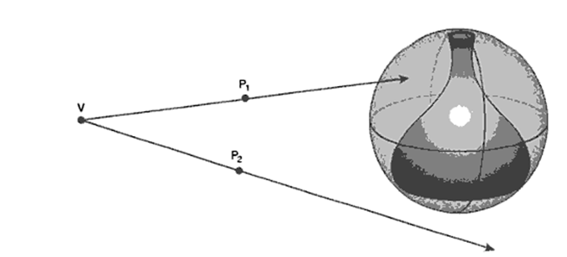
Bounding Volume Approach
Test for intersection of ray with the bounding volume of the object.
Typical bounding volumes are sphere, ellipsoid, rectangular solid.
If ray does not intersect bounding volume, no further processing ofthe object is needed.

Slide 51
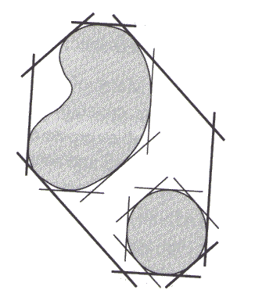
Using Hierarchies
If a parent bounding volume does not intersect with a ray, all its children bounding volumes do not intersect with the ray and need not be processed
Thus reduce the number of intersection calculations.

Slide 52
Space Partitioning Approach
Partition the space into a regular grid of equal-size volumes.
Each volume has associated with it a list of objects which are contained within or intersect the volume.
Intersection calculation is only applied to those objects that are contained within the partition through which the ray passes.
Objects lying within the partitions which do not intersect with the ray are not processed.

Slide 53
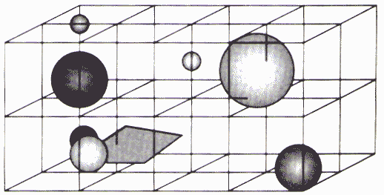
Contd…

Slide 54
Reflection
If the surface that the ray intersected was reflective, like a mirror, the ray tracer must determine the color at that point by finding, not only the color of the surface, but also the color of the reflection of any objects at that point
For instance, imagine a shiny wooden table
From where you look at it, you will be able to see the reflections of objects on the table
This is because the light from those objects travels to the table, bounces off it, and travels to your eye.

Slide 55
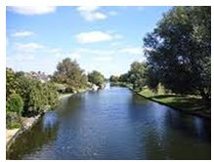
Example

Slide 56
Transparency
Transparency is modeled similarly to reflection, but instead of bouncing the new (or "spawned") ray off of the surface, the ray is bent into and through the surface to model refraction
Refraction is an optical phenomenon caused when light bends as it travels through a given substance

Slide 57
Shadows
Shadows are the third standard feature in ray tracing
Once you have determined an intersection, the shadows may be calculated by firing more rays--one at each of the light sources
If any opaque (that is, non-transparent) objects intersect a ray, then no light can arrive at the first object via that ray, and the surface is in shadow
These shadow rays are sometimes referred to as shadow feelers, since they are used to "feel around" for the light sources

Slide 58
Ray Tracing – Drawbacks
it is not fast
  The software actually mathematically models the light rays as they bounce around this virtual world, reflecting, refracting and generally having a good time until they end up in the lens of your imaginary camera
  This can quite literally involve millions and billions of floating-point calculations and this takes time
  Tracing images can take anything from a few minutes to many days

Slide 59
Scan –Line Method
An image space method
extension of scan-line algorithm for polygon filling
Computes and compares depth values along the various scan-lines for a scene
Two important tables are maintained:
  The edge table
  The surface facet table (Polygon table)
Notes:
Across each scanline, depth calculations are performed to determine which surface is nearest to the view plane at each pixel position. When the visible surface has been determined for a pixel, the surface color for that position is entered into the frame buffer.

Slide 60
Contd…
The edge table contains: all edges y-sorted
  Coordinate end points of each line in the scene
  The inverse slope of each line
  Pointers into the surface facet table (polygon table): to identify the surfaces bounded by each scan line
The surface facet table contains: all polygons
  The coefficients of plane equation
  Intensity information
  May also contain pointers into the edge table

Slide 61
Contd…
Active list
  Contain only edges across the current scan line
  Sorted in order of increasing x
  The active list stores only those edges that cross the scan-line in order of increasing x
Flag for each surface
  Indicate whether a position along a scan-line is either inside or outside the surface

Slide 62
Contd…
Pixel positions across each scan-line are processed from left to right
At the left intersection with a surface the surface flag is turned on
At the right intersection point the flag is turned off
We only need to perform depth calculations when more than one surface has its flag turned on at a certain scan-line position

Slide 63
Contd..
Active list for scan line 1
  AB, BC, EH, and FG
    Between AB and BC, only
    the flag for surface S₁ is on
      No depth calculations are necessary
      Intensity for surface S₁ is entered into the refresh buffer
    Similarly, between EH and FG, only the flag for S₂ is on
B
y_{v}
E
F
A
Scan line 1
S₁
S₂
Scan line 2
H
Scan line 3
C
D
G
x_{v}

Slide 64
Contd…
B
y_{v}
E
F
A
Scan line 1
S₁
S₂
Scan line 2
For scan line 2, 3
  AD, EH, BC, and FG
    Between AD and EH, only the flag for S₁ is on
    Between EH and BC, the flags for both surfaces are on
      Depth calculation is needed
      Intensities for S₁ are loaded into the refresh buffer until BC
  Take advantage of coherence
    Pass from one scan line to next
    Scan line 3 has the same active list as scan line 2
    Unnecessary to make depth calculations between EH and BC
H
Scan line 3
C
D
G
x_{v}

Slide 65
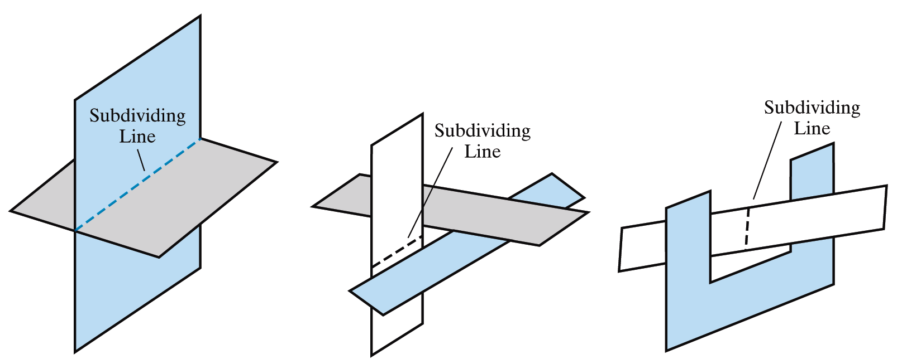
Scan-line Limitations
The scan-line method runs into trouble when surfaces cut through each other or otherwise cyclically overlap
Such surfaces need to be divided

Slide 66
Binary Space Partitioning Algorithms

Slide 67
BSP
Efficient method for Determining object visibility by painting surfaces onto the screen from back to front
  Like the painter’s algorithm
Particularly useful
  The view reference point changes
  The objects in a scene are at fixed positions

Slide 68
Visible Surface Determination
Binary Space Partitioning (BSP)
  Recursively cut up space
  The scene is represented by a BSP-tree
Identifying surfaces
  “inside” and “outside” the partitioning plane
Intersected object
  Divide the object into two separate objects(A, B)

Slide 69
Recursively subdivide space to determine depth order:
  Think of scene as clusters of objects
  Find a plane that partitions two clusters
  Therefore, an object on same side of the plane as the viewpoint can obscure, but cannot be obscured by, an object on the other side.
  Recursively subdivide clusters by finding appropriate planes
  Store subdivision (space-partioning) planes in a binary tree
    Node: stores a polygon and a space partioning plane
    Left child: subtree of objects on negative side of plane (in front)
    Right child: subtree of objects on positive side of plane (behind)

Slide 70
P₂
P₁
P₁
C
front
back
D
A
P₂
P₂
front
back
front
back
B
front
back
back
front
A
C
B
D

Slide 71
Algorithm
Select a polygon and make it the root
Partition space into two half-spaces determined by the normal of the root polygon
If a polygon is intersected by the plane, split the polygon into two polygons, one in each half space
Select one polygon in the root’s front and one in the root’s back and assign them as children of the root
Recursively subdivide space depending on each of the children generated from step 4.
Stop when a sub-space contains a single polygon

Slide 72
BSP Tree example
Initial Scene:
1
4
3
2
5

Slide 73
BSP Tree example
Select polygon 3 as the root
(arbitrary choice)
3
front
back
1
1
2
4a
4b
5
4a
4
4b
3
2
5

Slide 74
BSP Tree example
Select polygons 2 and 4b as the next nodes
3
1b
4a
1
front
back
1a
4
4b
2
4b
3
2
5
1b
4a
1a
5

Slide 75
BSP Tree example
Select polygon 1b as the next node
3
front
back
1b
4a
2
4b
1
1a
4
4b
3
1b
1a
5
2
5
4a

Slide 76
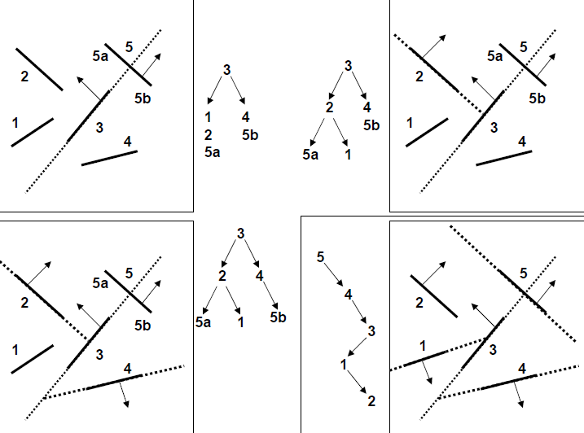
Example

Slide 77
END

